Slide 1
Advanced Imaging for Retinopathy of Prematurity
Benjamin K. Young MD, MS Assistant Professor of Ophthalmology, Casey Eye Institute

Slide 2
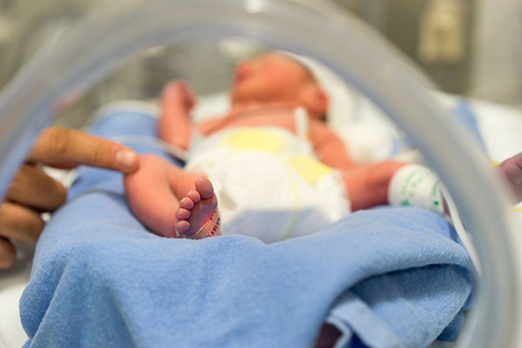
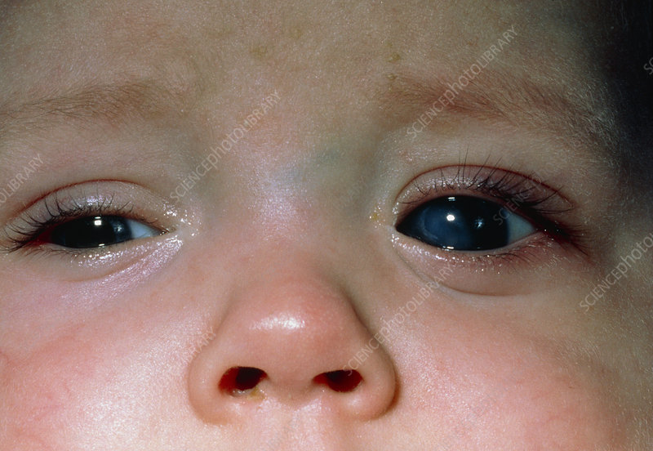
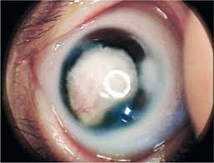
Premature babies are surviving younger and younger with modern medicine
But these babies are at high risk for blindness from infancy
Premature baby who went blind from scar tissue inside the eye due to “Retinopathy of Prematurity” (ROP)
This is the most common cause of blindness in children in the United States

Slide 3
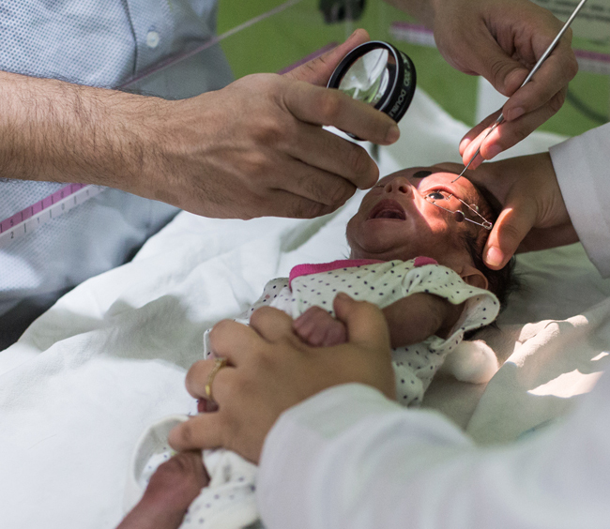
Fortunately, we can prevent this with screening
Doctors examine premature babies to look for very early signs of scarring inside the eye
If we catch this in time, our treatments (laser or medication) can essentially always stop the baby from going blind

Slide 4
However, screening can be subjective and is challenging to perform
Our team at OHSU has developed a new scanning camera that can get ultrahigh resolution detail of the retina in 3D

Slide 5
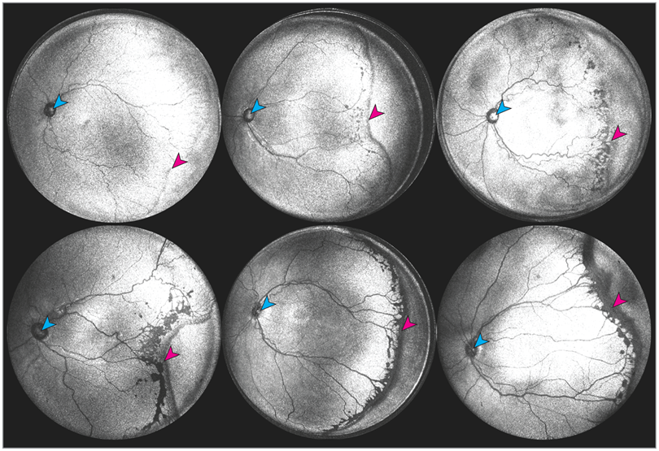
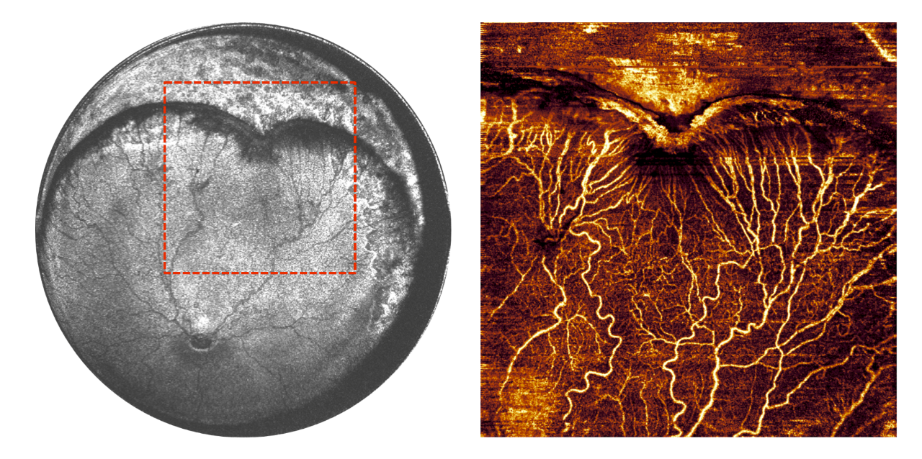
This project funded by the Knights Templar Eye Foundation aims to use this new imaging technology to learn more about why ROP happens, and use advanced analytical methods to understand how it progresses.

Slide 6
Thank you for your support in our shared mission to stop blindness in children!

